Slide 1
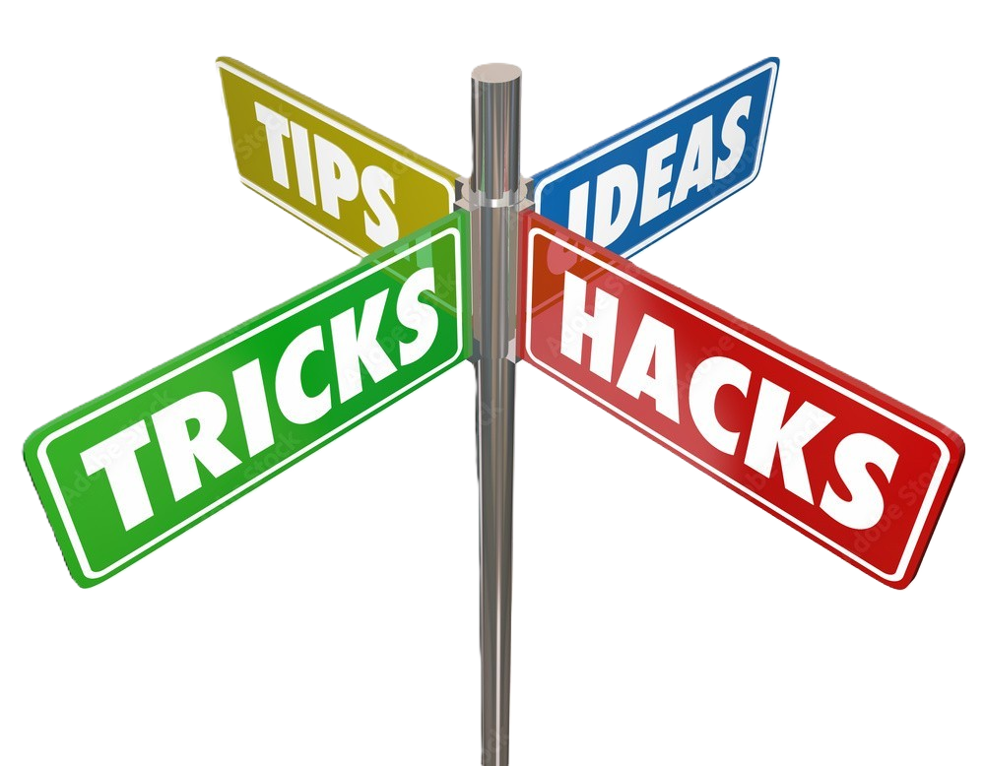
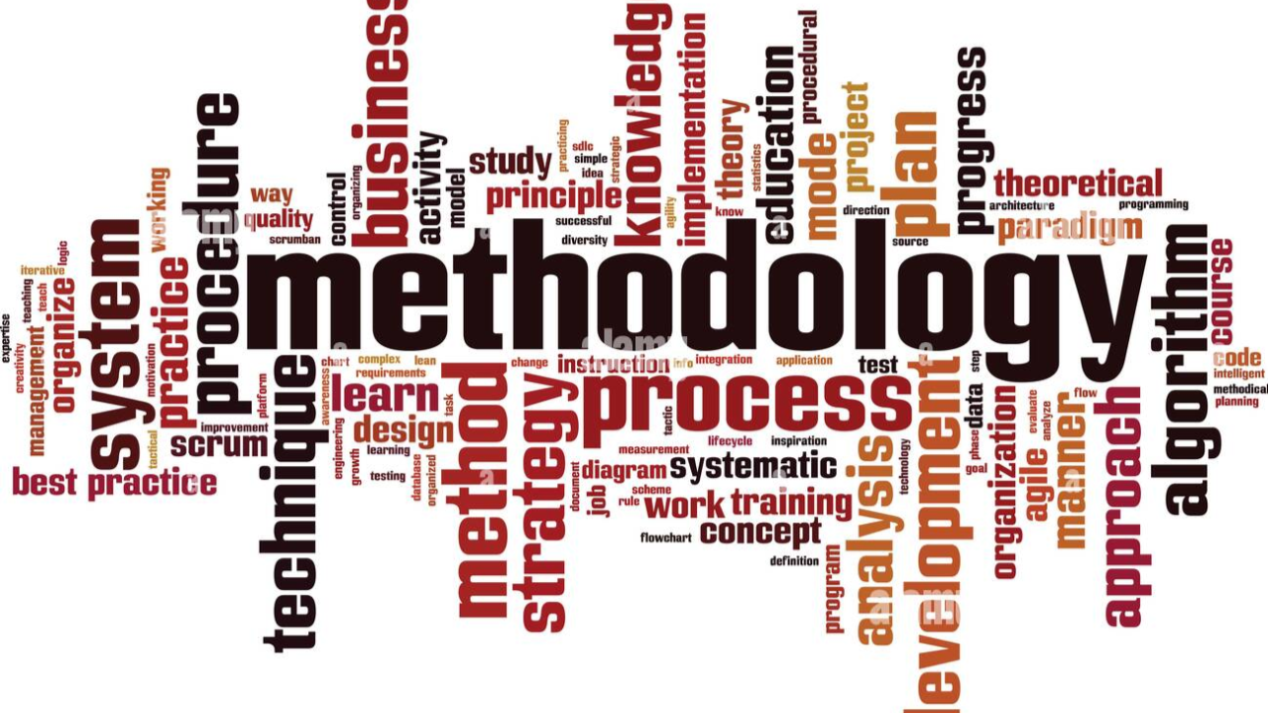
History Research
John Musgrove
CISA, CRISC, CPDSE
BS, MS, MA, MS, MS

Slide 2
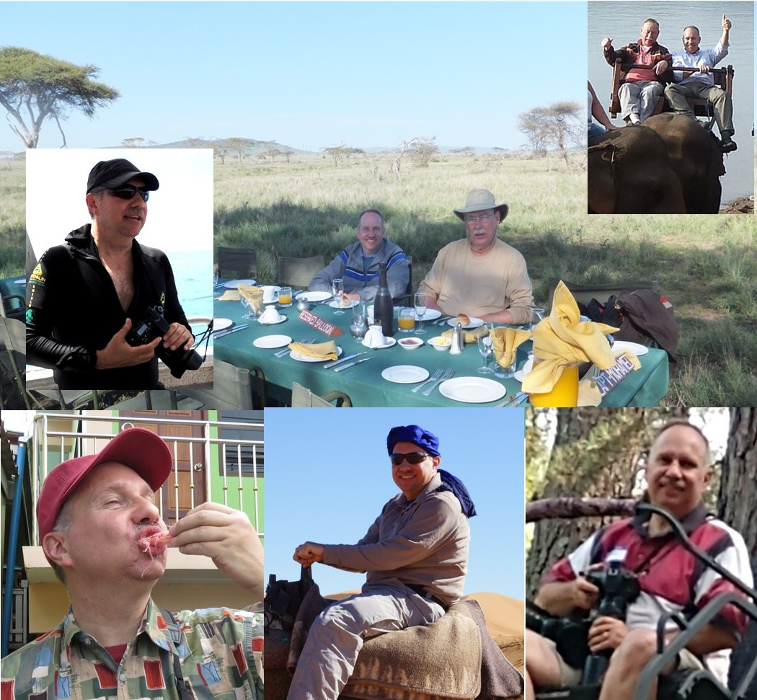
A Little About Me . . .
Five University Degrees: BS, MS x4
Multiple Professional Certifications
Decades of experience researching
World Traveler
40 States
52 Countries on Six Continents
Award-winning Photographer
Published Author
Renowned Baker

Slide 3

My Real Credentials
Library Nerd
History Geek
Voracious Reader
Hooked on Research
Obsessive Compulsive (Whim Driven)
Tendency toward ADHD
Digital Packrat
Organization Addict

Slide 4
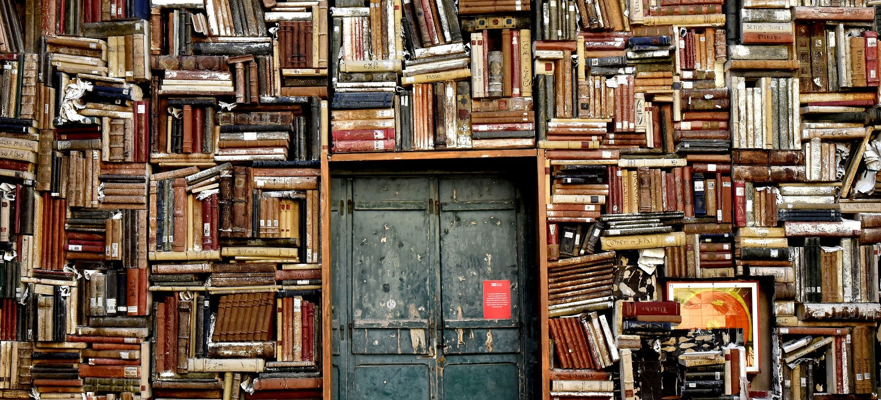
Collecting is just the beginning . . .
Then it is just keeping it organized, available, current, readable, accessible, cohesive, articulate, focused, meaningful, and neat.

Slide 5
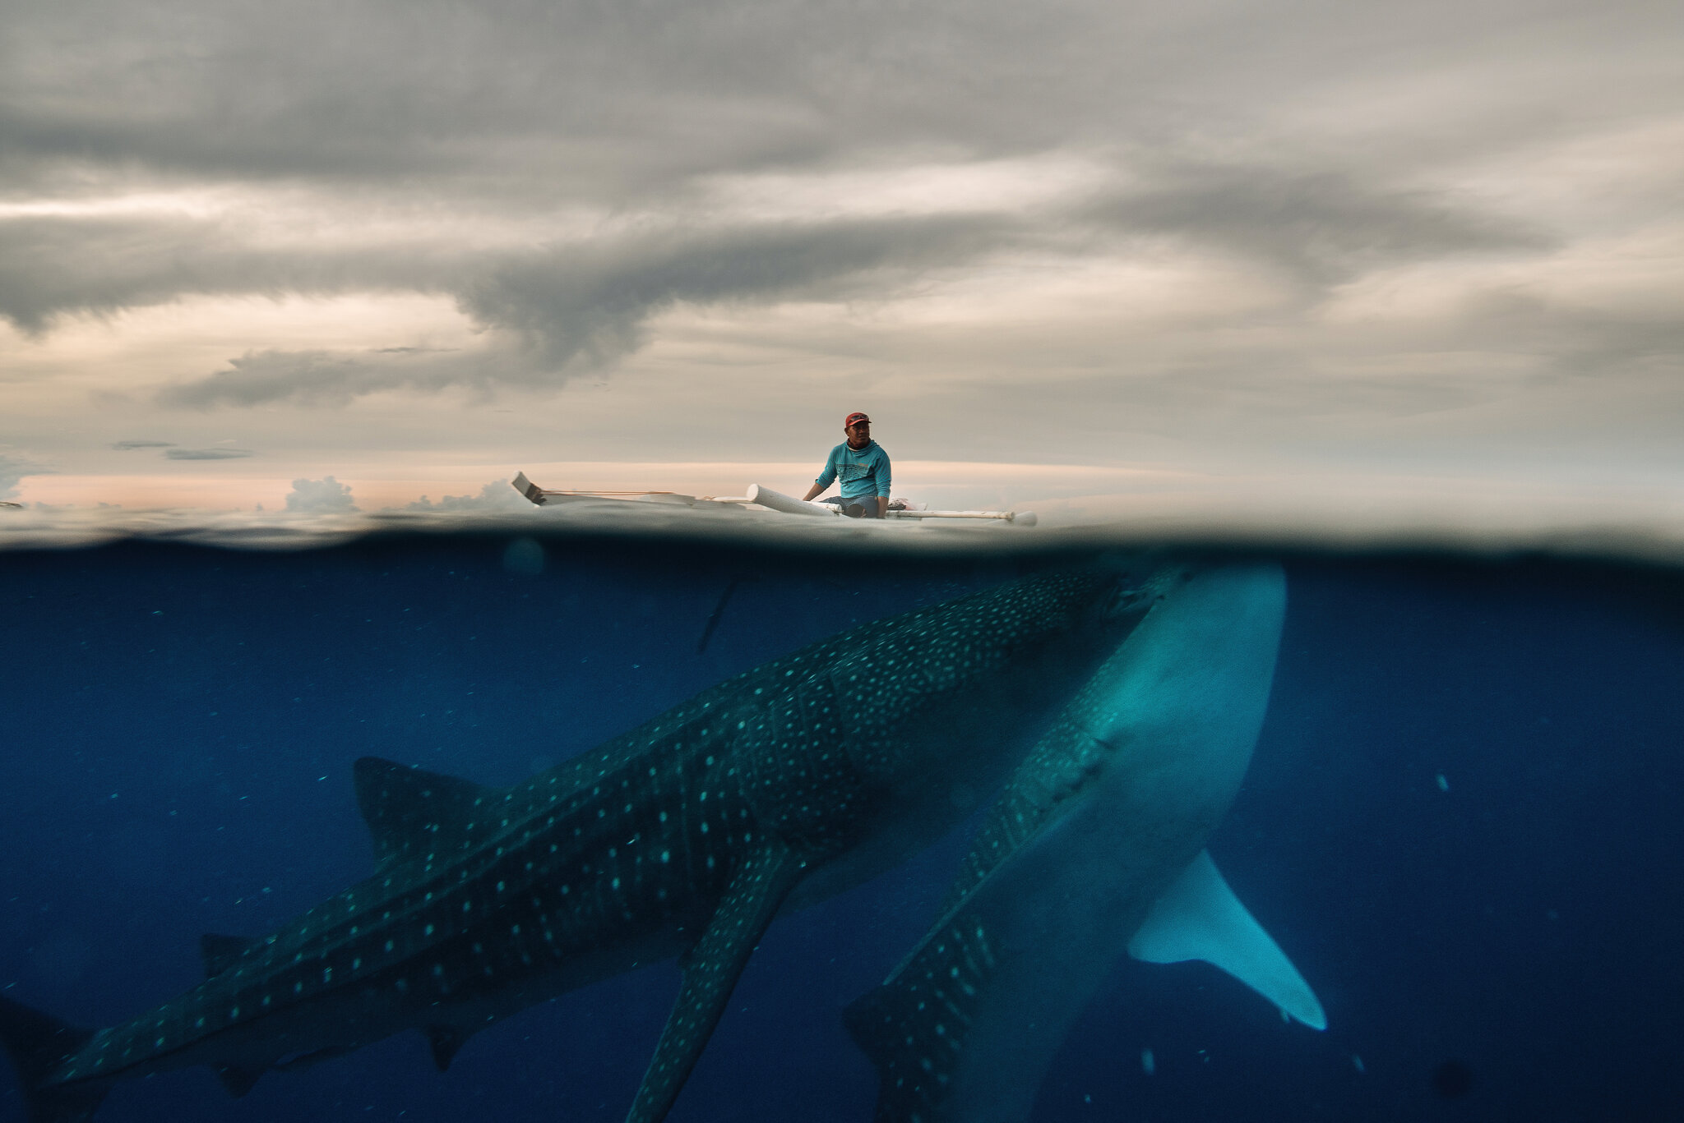
Research as a Discipline
Open mind
Be curious
Question sources
Check your biases
Investigate motives
Avoid sugar-coating
Get opposing views
Dive deeeeeeeeep

Slide 6
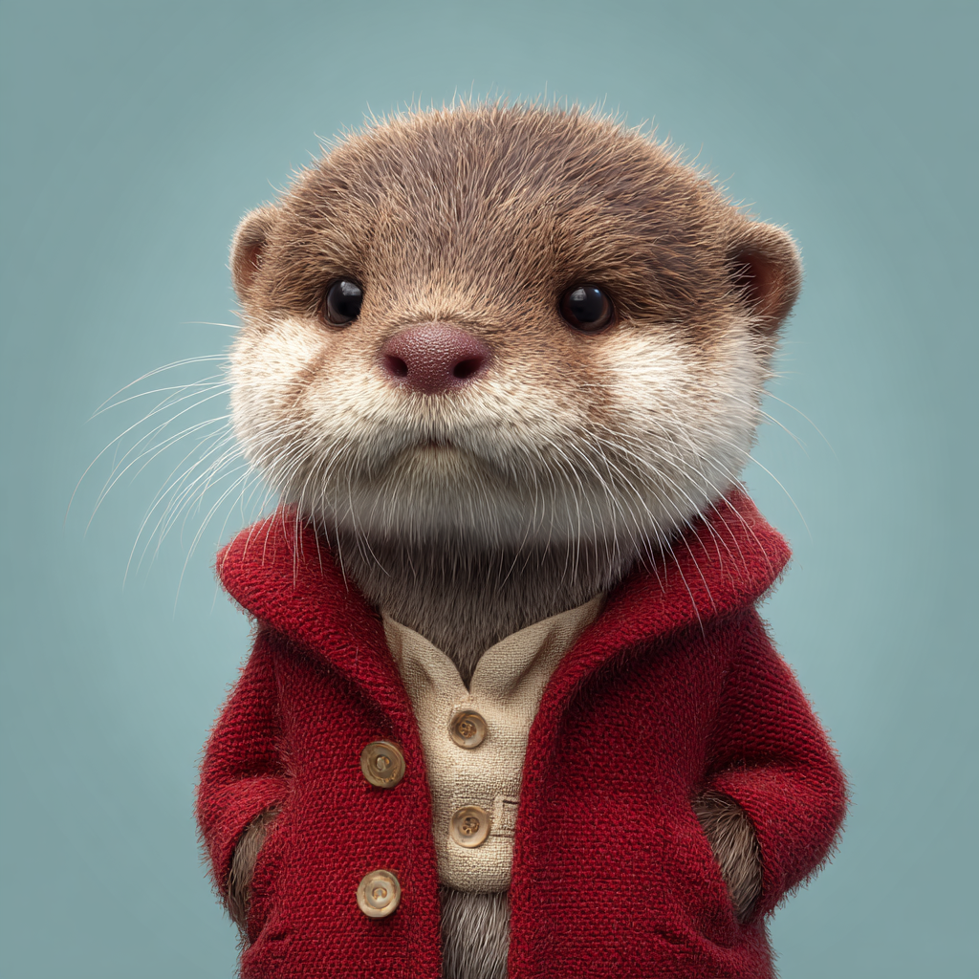
Organize Your Research Materials
O Y
R
M
World View – Topic Focus and Direction
Region View – Outline of Information
Local View – Software, Hardware
Analysis – Making Sense of Collections

Slide 7
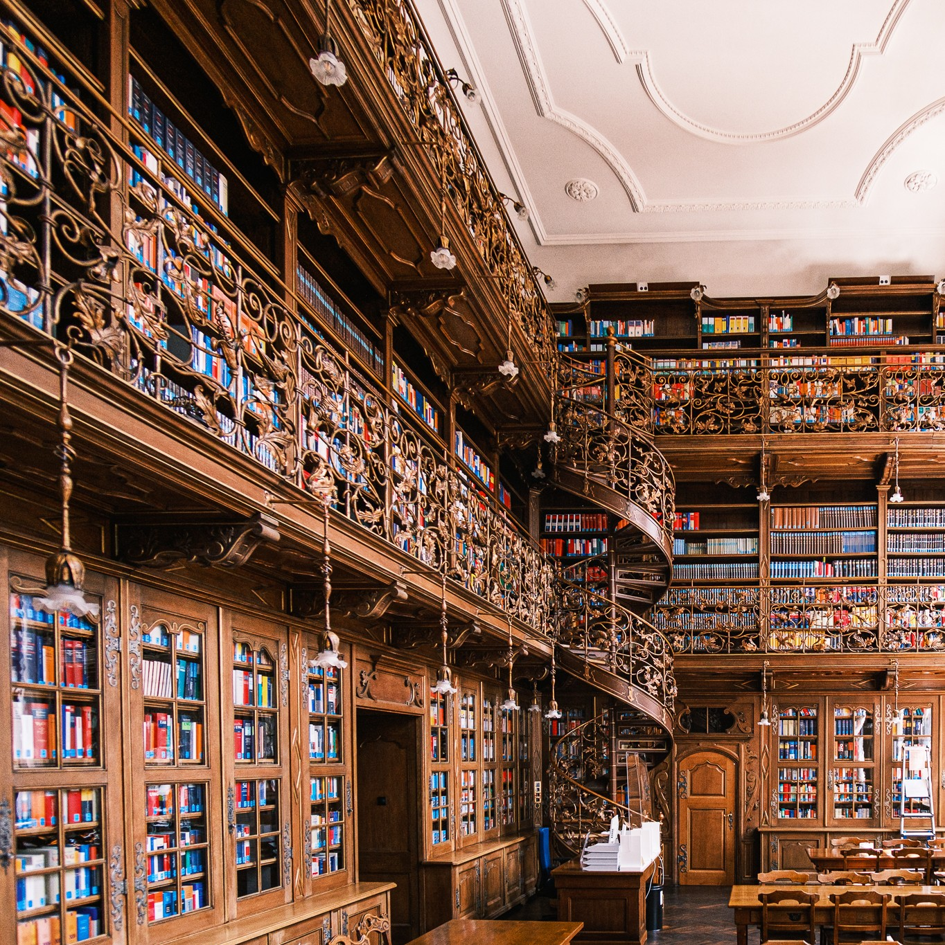
OYRM: World View
Research Topic(s)
Too Narrow,
or Too Deep?
Sources
Libraries
Online Repositories
Historians & Re-enactors
Museums
Writers
Professors / Academics

Slide 8
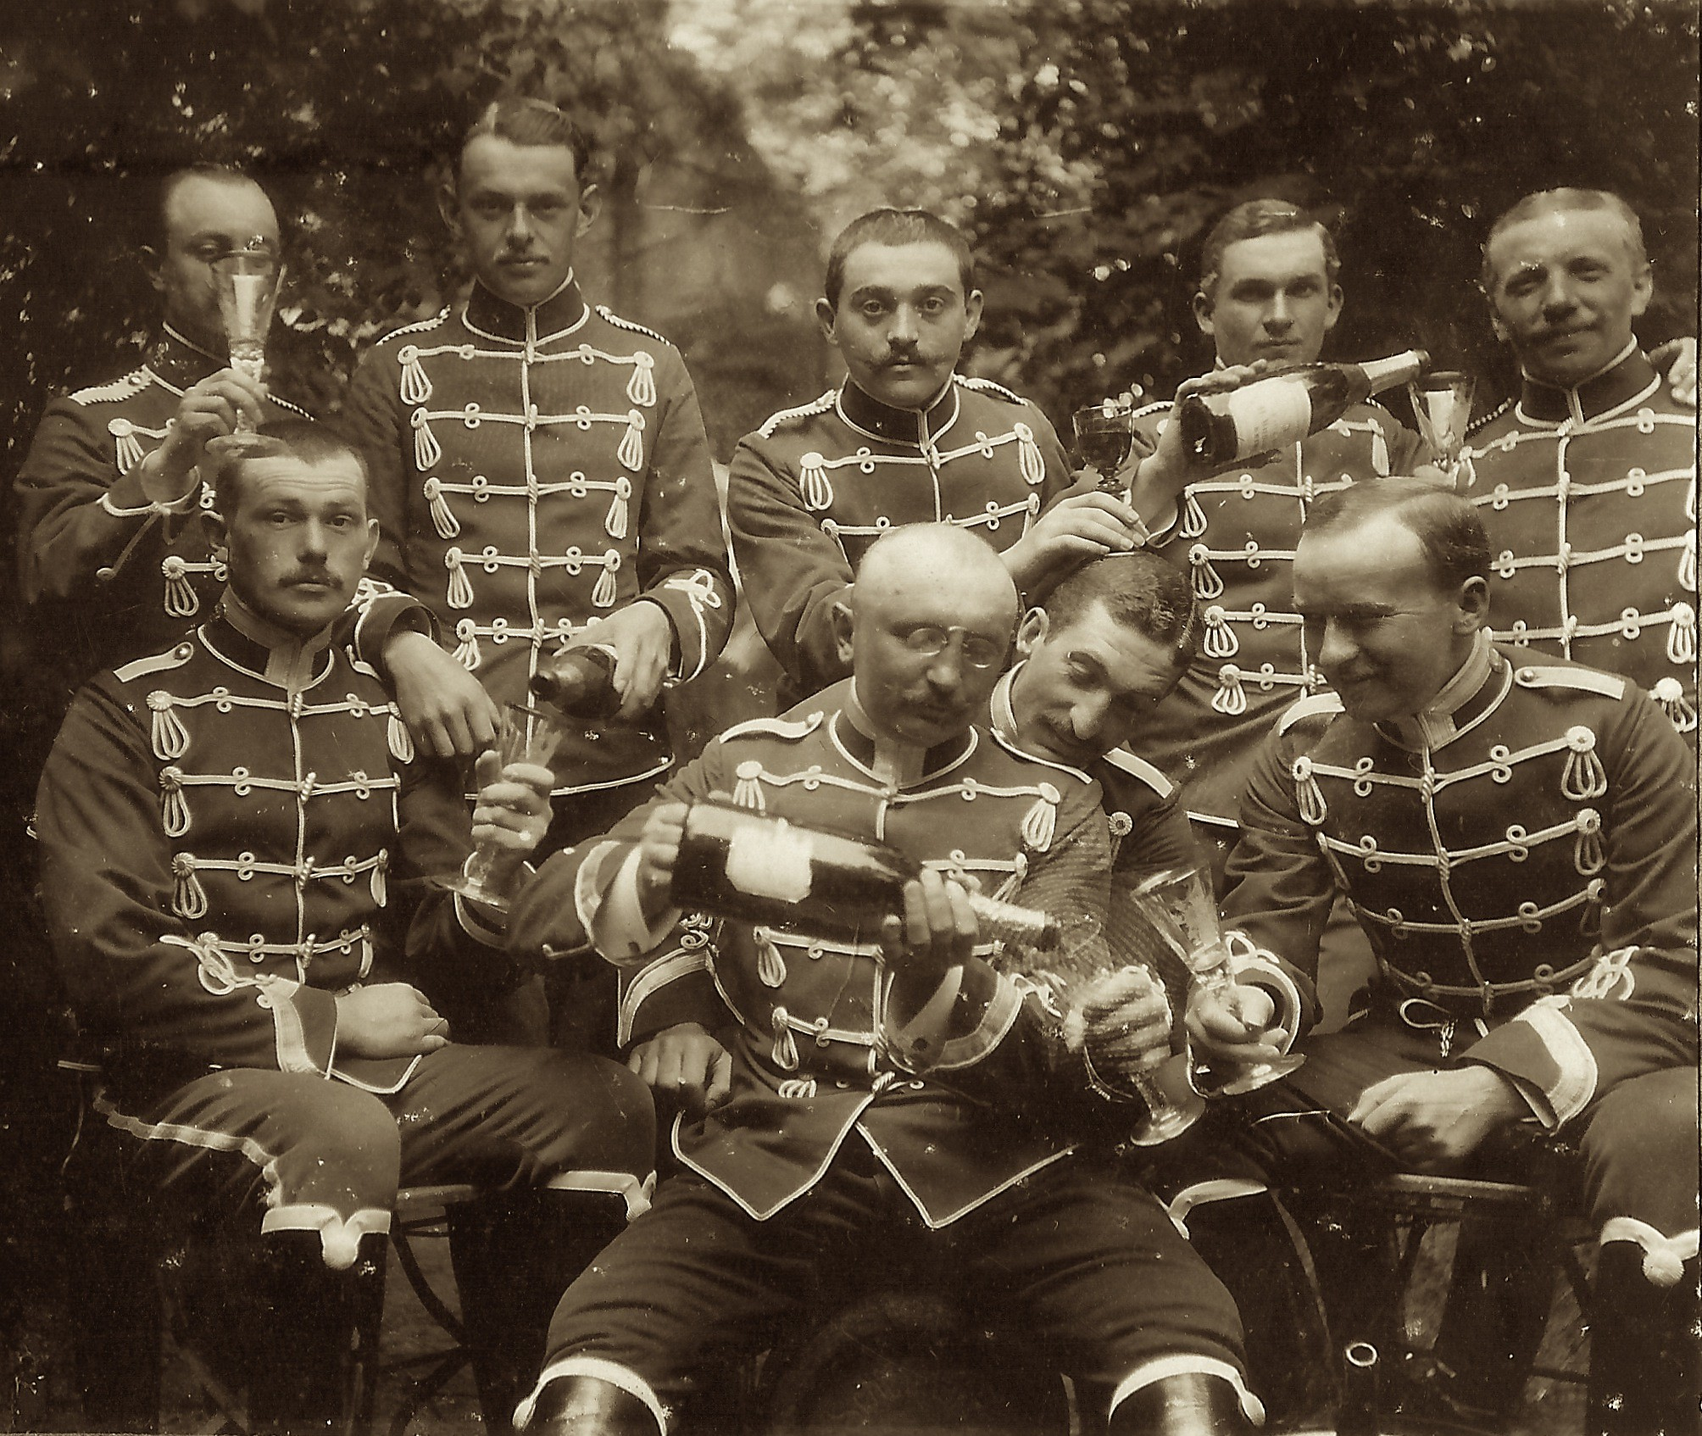
Bloggers, Databases, Lists, & Links
Interwebs and World Wide Browsing
Bookmark, Bookmark, Bookmark!
Organize bookmarks in browser
Leverage others’ work as starting point
Practice effective searches
Key words
Wildcards
Specific Terms
Limiting Results
Bookmarking Searches Can Save Hours!

Slide 9
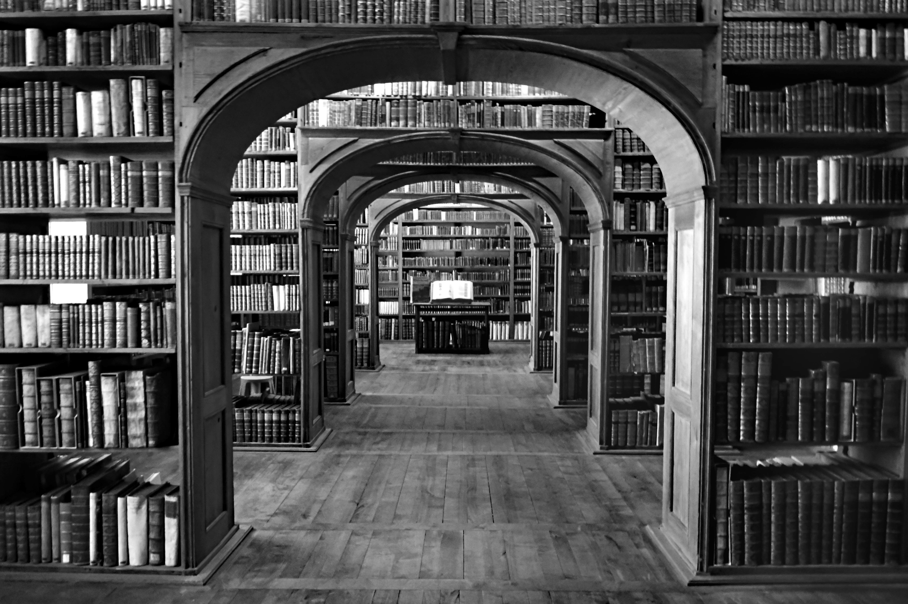
Librarians RULE!
Have made information their livelihood
Are experts on their collection(s)
Know sources or people or both
Have embraced technology fully
Often specialize in particular subjects

Slide 10
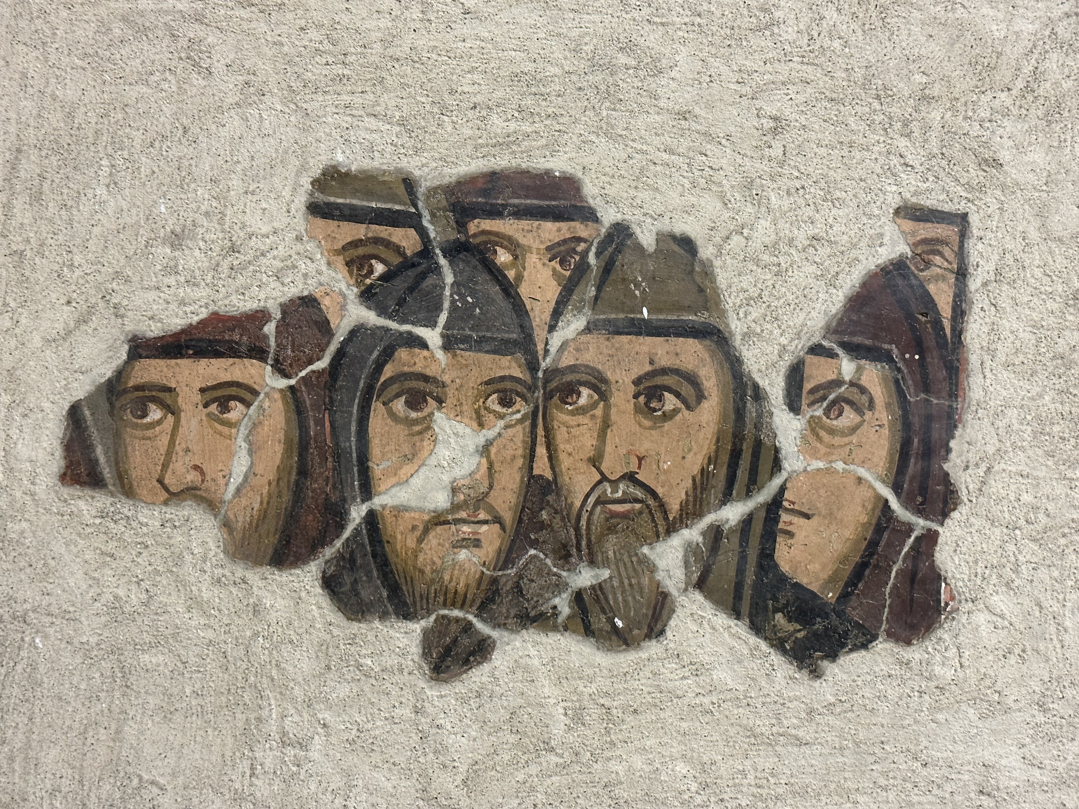
Historians
Thrive on sharing their knowledge
Experts in a Time Period, or Milieu
Academic or Independent
Higher Learning
Museums
Reenactors
How to FIND them:
Historical Program Agenda
Authors – ‘Contact Me’ particulars
Academic Departments
Government Agencies (DHS, Archives)
Internet: LinkedIn

Slide 11

OYRM: Region View
Catalog of Sources – Specific Details
Timelines
Main Character(s)
Life Events, Milestones
Supporting Cast
Contemporary Headlines
People
Language
Technology
The Arts
Clothing and Everyday Ephemera

Slide 12
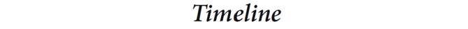
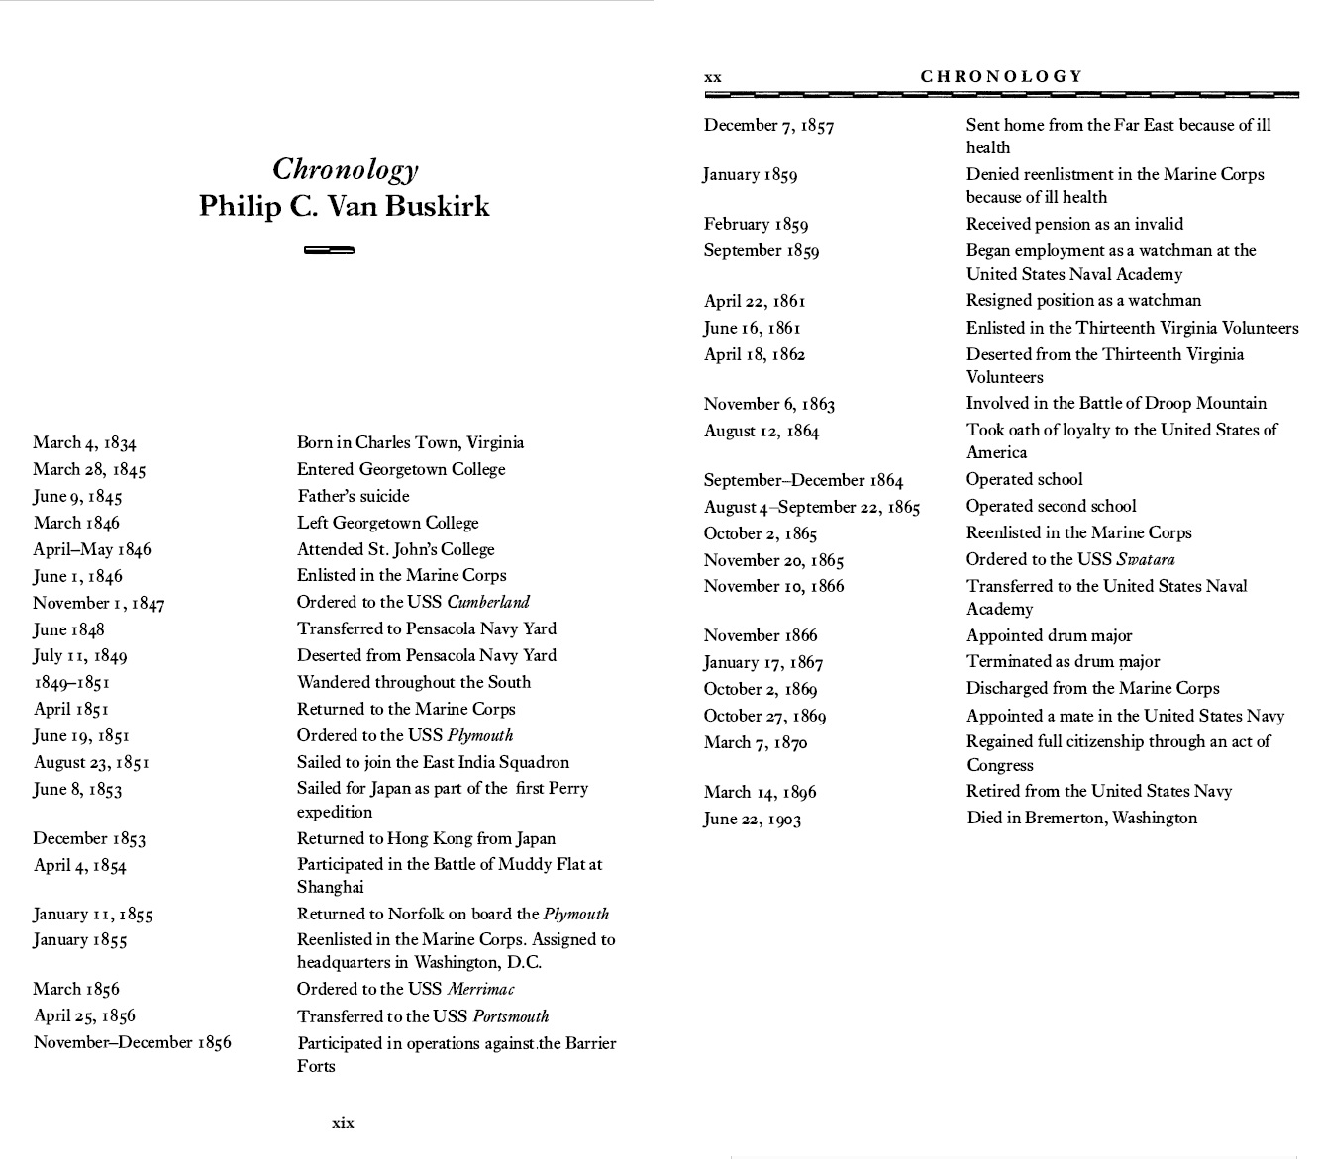
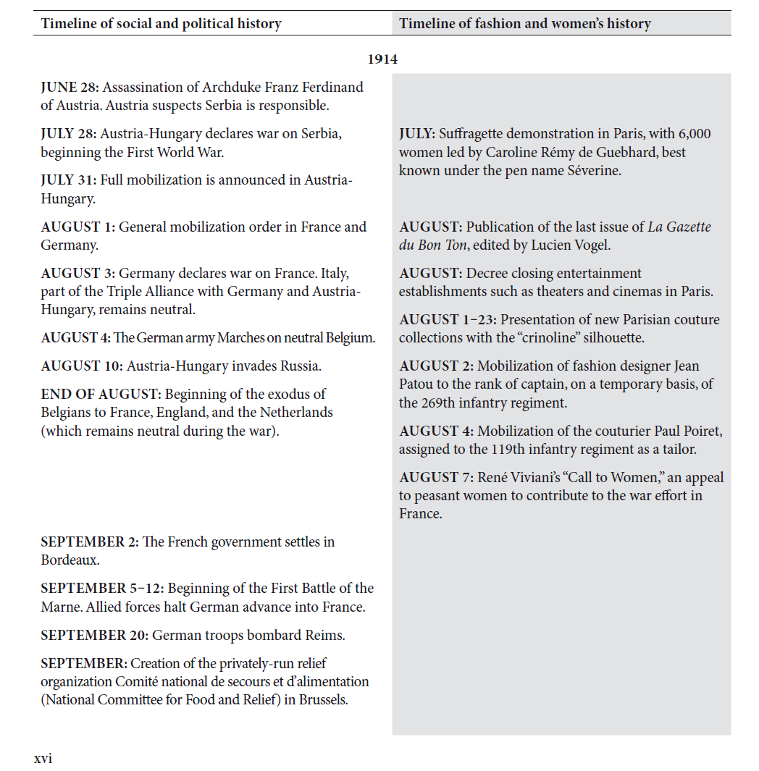
Two Timelines from Published Works
Burg, Barry Richard., Van Buskirk, Philip Clayton. An American seafarer in the age of sail. United Kingdom: Yale University Press, 1994.
Fashion, Society and the First World War: International Perspectives. India: Bloomsbury Visual Arts, 2021.

Slide 13

Contemporary Technology
Communication
Channels
Methods
Food
Preparation
Agriculture
Trading Partners
Cultural Fusions
War and Military Might
Weapons
Tactics
Delivery Systems

Slide 14
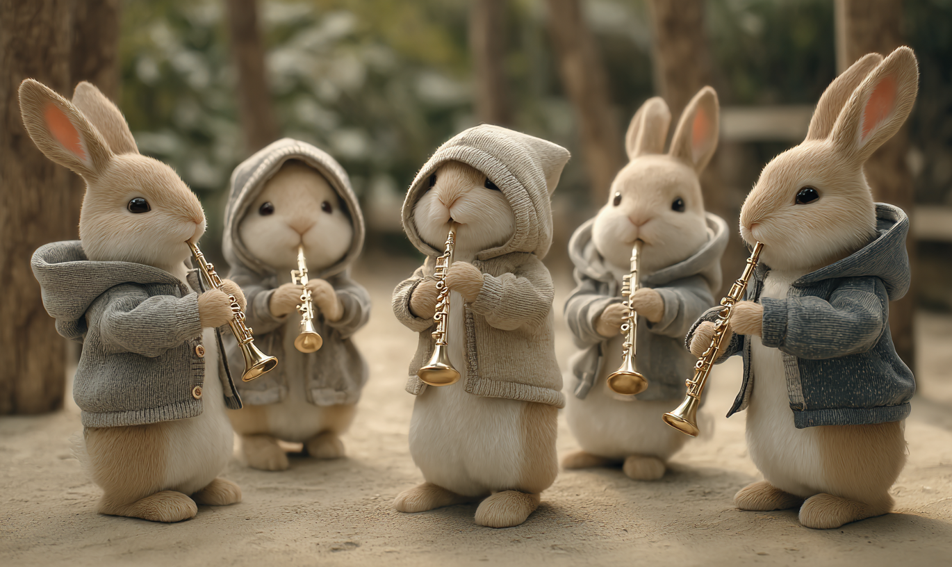
Contemporary Arts & Creative Expressions
Exposure to, Enjoyment of
Accolades vs Sales / Income
Music
Lofty Compositions
Popular Amusements
Visual Modes
High Art – Painting, Sculptures
Low Art – Graphics, Posters, Graffiti
Literature
Popular vs celebrated or promoted

Slide 15
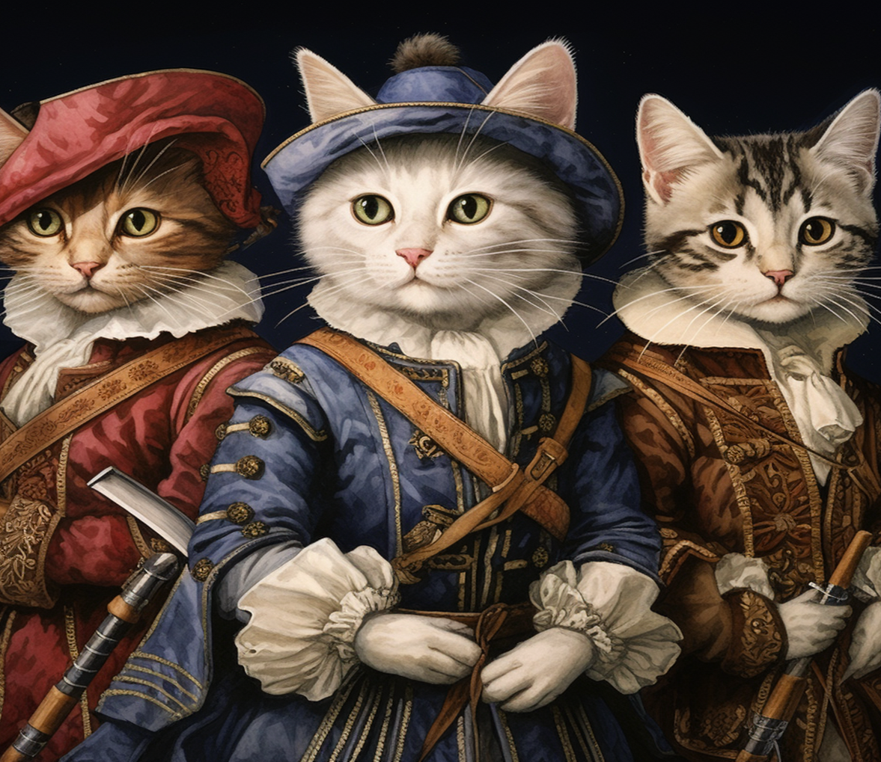
Fashion, Clothes, Uniforms
Vestments Reveal
Status
(Societal) Role
Wealth (or poverty)
Conformance to local norms
Gender – Toga vs Stola
Complexities (or lack of) Convey
Time investment
Independence
Commitment to the role
Colors and / or Fabric Indicate
Nobility
Emotional State (mourning)

Slide 16
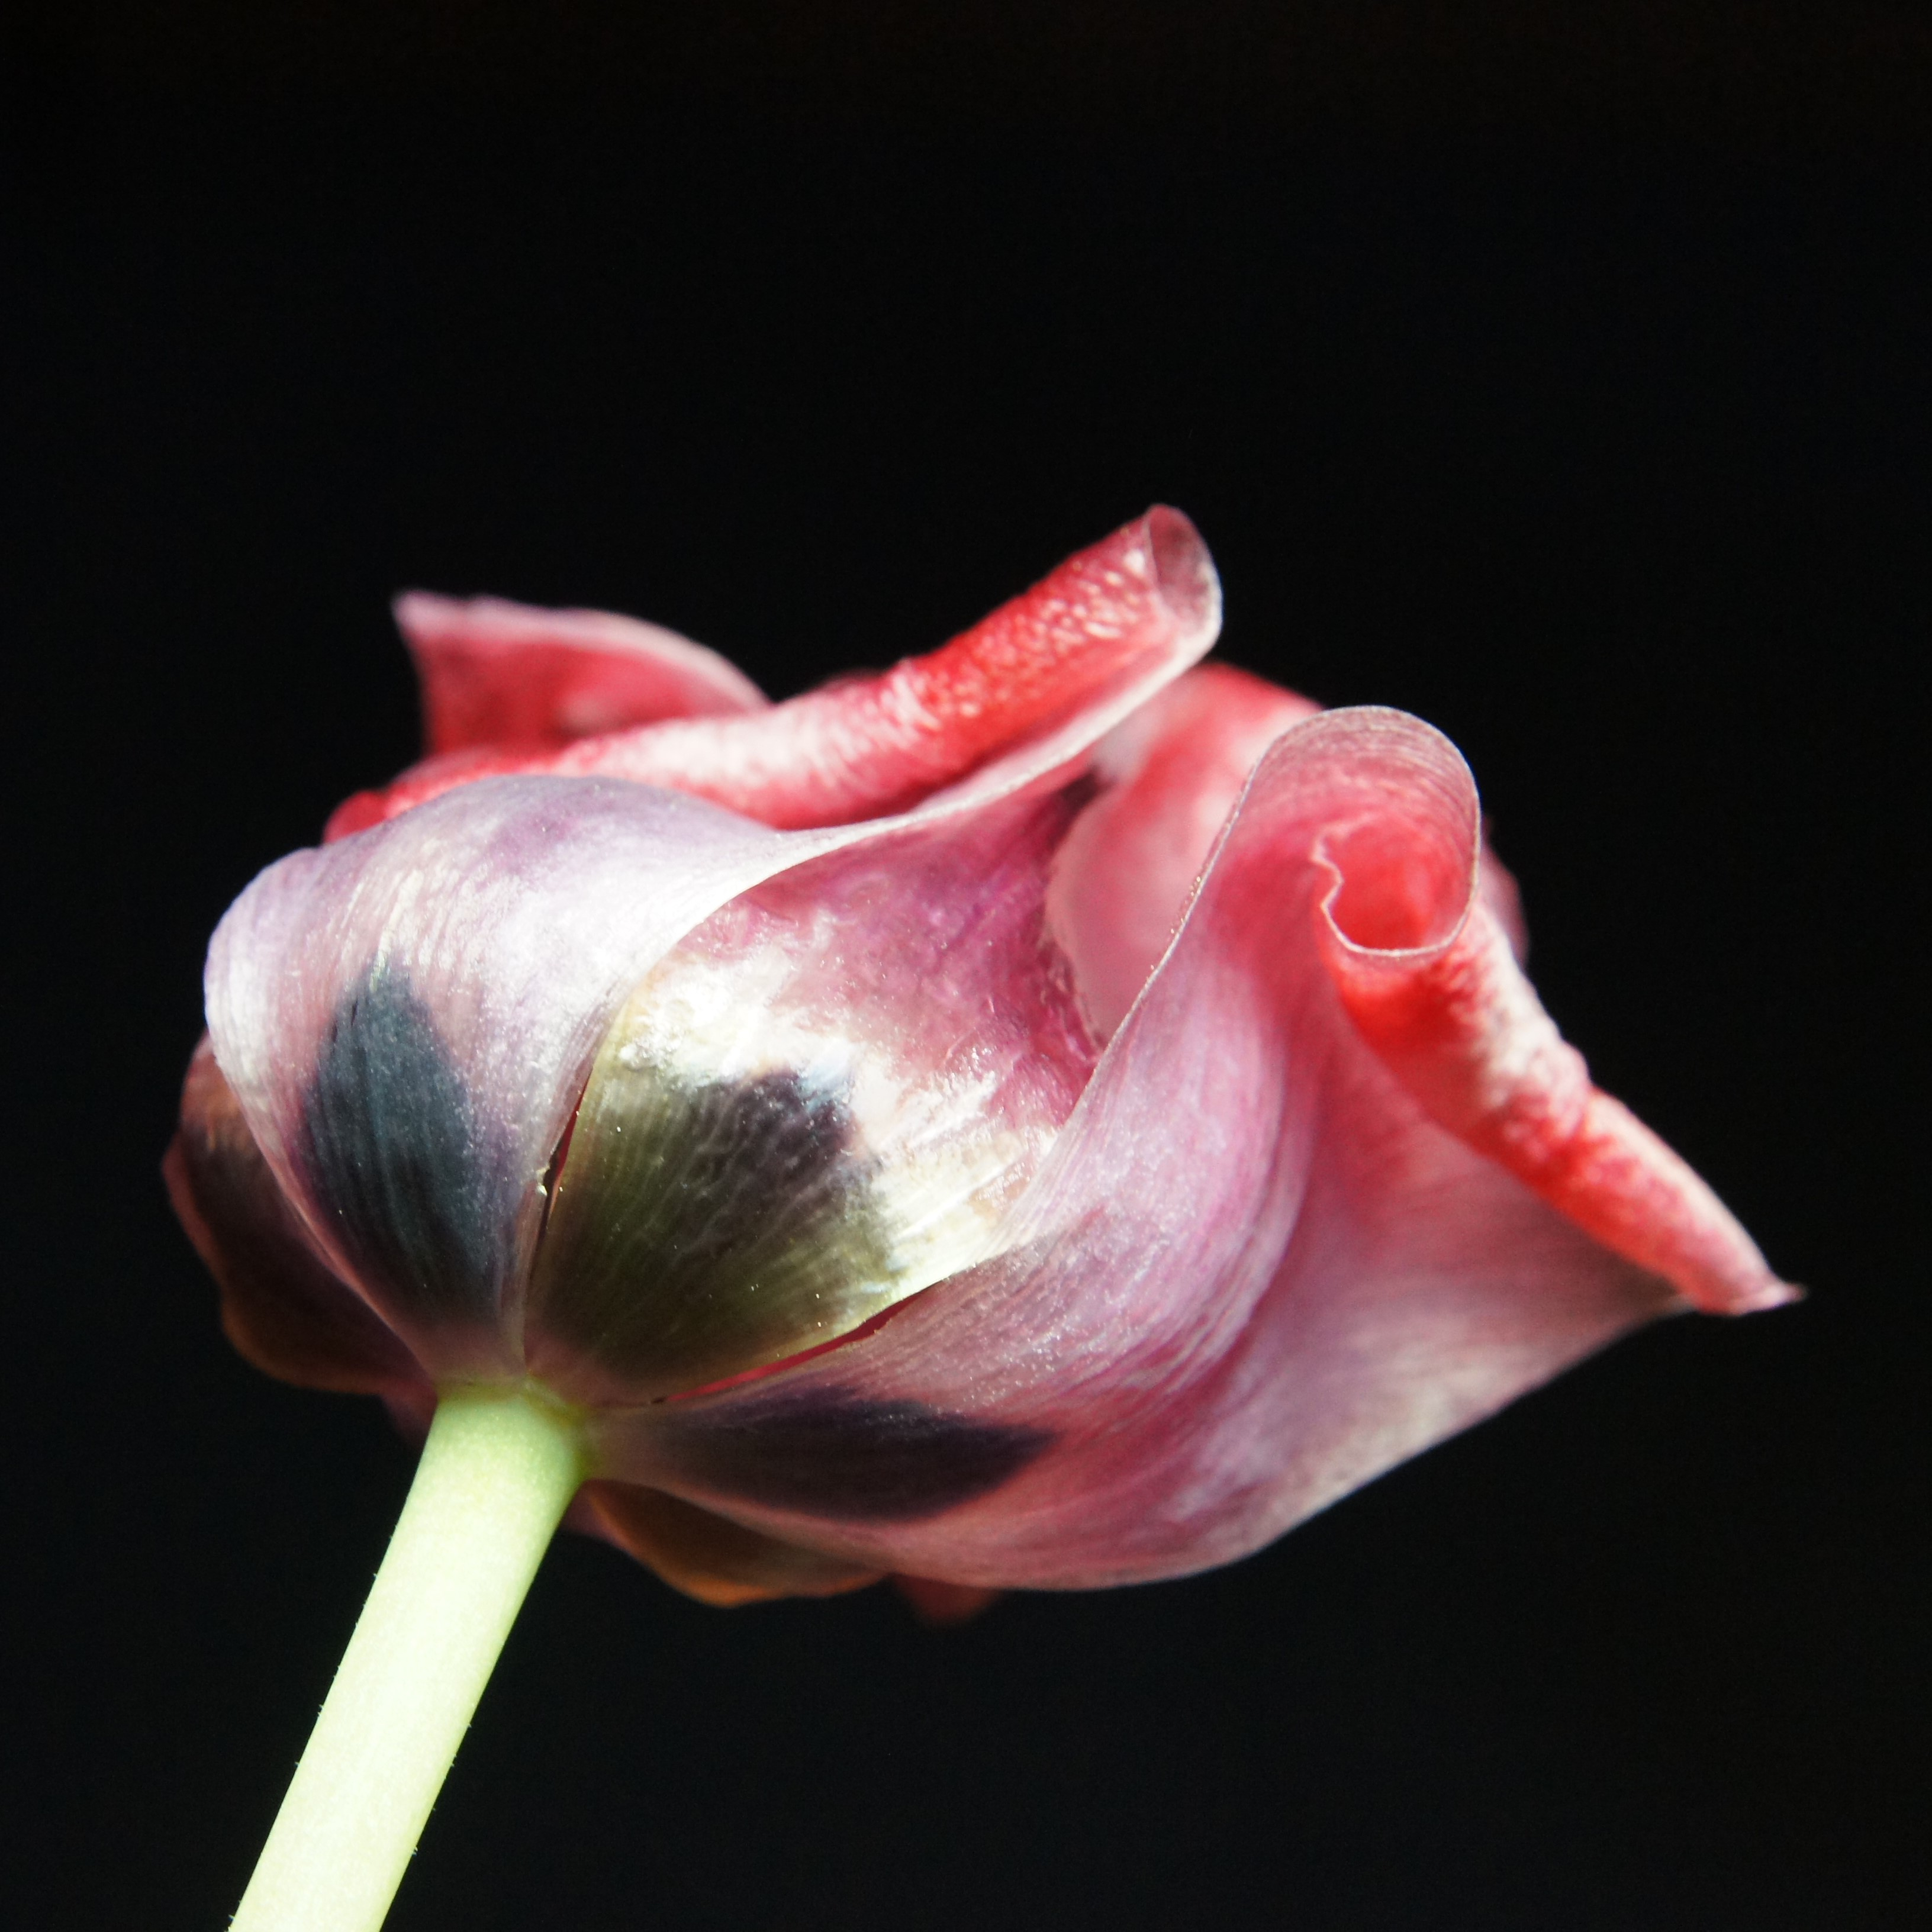
Ephemera
Personal Effects, Papers, Collections
Handwritten Letters, Cards
Diaries
Log Books
Public Printed Matter
Marginalia
Personal Library Catalogs
Scrapbooks

Slide 17
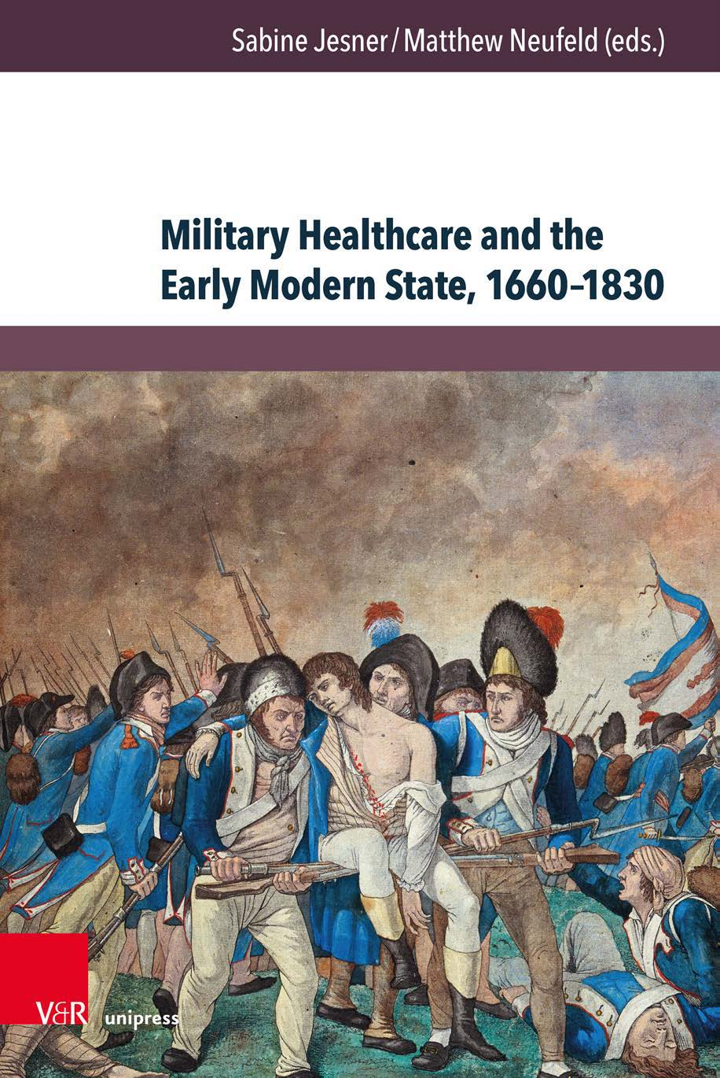
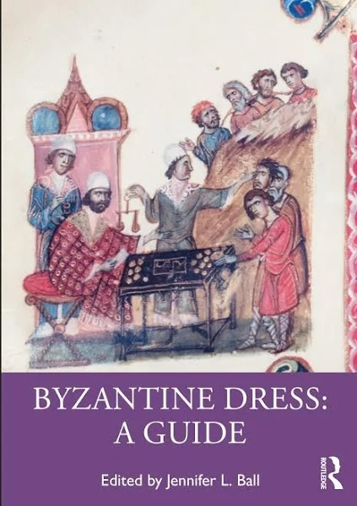
Sources, Sources, Sources
Many Academics Freely Share Their Work
https://www.hathitrust.org/
https://www.jstor.org/
Digital Public Library of America: https://dp.la/
Both of these are free on Open Access →
https://oapen.org/
Explosion of History Podcasts and Stories
Listen Notes
PodBean
PodChaser
LibSyn

Slide 18
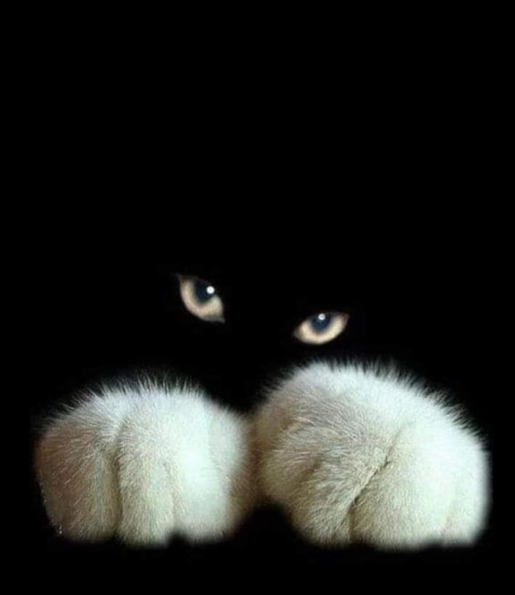
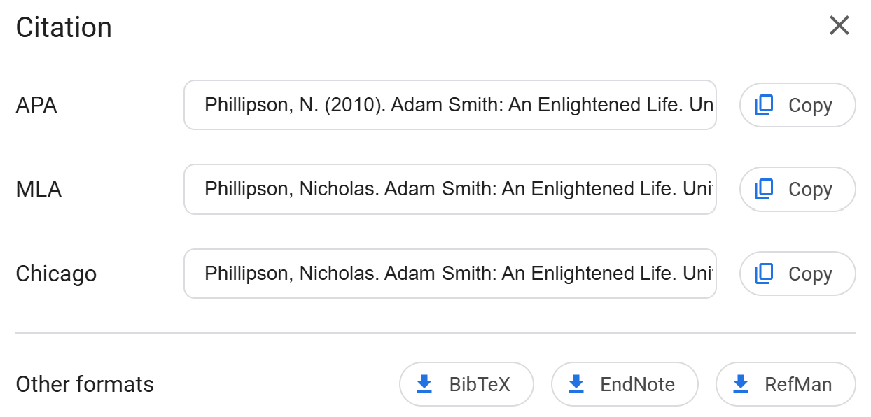
World Cat and Google Books
World Cat – full online catalog of every book registered in libraries
Embedded in Google Books
worldcat.org
Google Books has out-of-copyright works
Scanned / OCR’d and Free to Download
https://books.google.com/
Built-in Citation Generator!

Slide 19
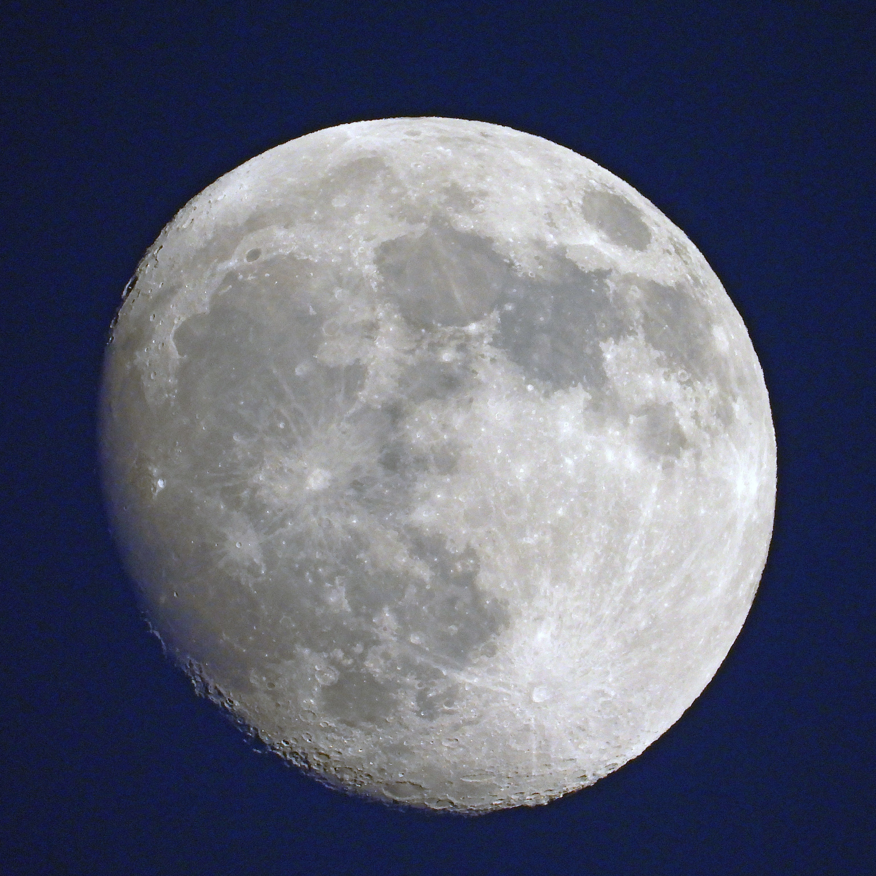
Libraries > Gold
Organized Repositories of Knowledge
Municipal (city/county, state, federal, int’l)
Institutions and Foundations
Academia
Museums
‘Embedded’
Digital / Completely Online
Internet Archive
JSTOR
DPLA
HathiTrust
Taylor & Francis

Slide 20

OYRM: Local (Home) View
Lists, Annotations, Footnotes, Appendices, Catalogs, Bibliographies
Software!
Digital Organizational Tools
Microsoft Office (Suite)
Google Docs
Open Office
WordPerfect (Corel Suite)
Folders – Be consistent in naming
Files – all related files in one directory
Metadata – tags and search terms
Only 1 file should be ‘Source of Truth’

Slide 21

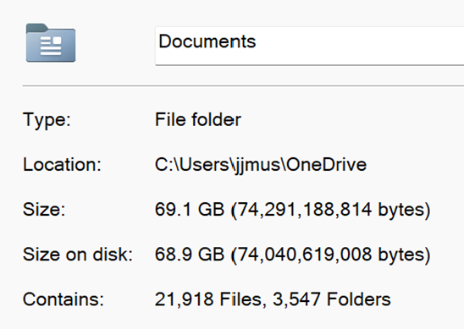
File Storage and Management
Online Storage (Free / Paid)
Local Digital Mass Storage
Microsoft – 5 Gb / 1 Tb
Google Drive – 15 Gb / 100 Gb / 2 Tb
Apple – 5Gb / 50Gb / 200Gb / 2, 6, 12 t
USB (A, C)
$10-30 / Terabyte
Portable, Packable, Lose-able!
NAS – Network Attached Storage
$100 / Terabyte
1 Tb = 14 copies of my One Drive
Internal Hard Drive (Primary or 2nd)
Desktop – standard or micro PC
Most Laptops are off-limits
Will not work with tablets or phones

Slide 22
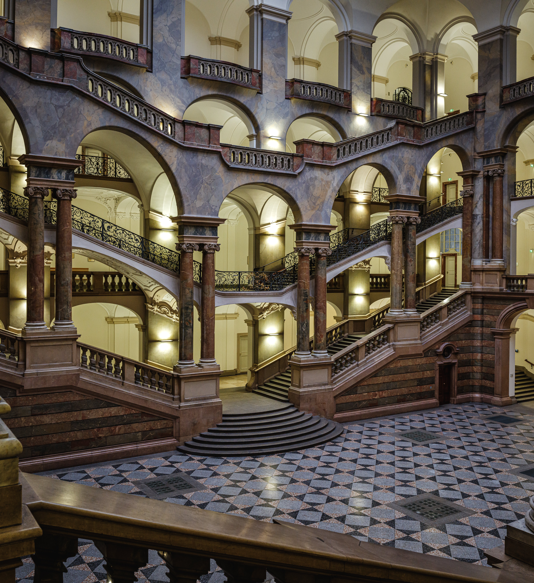
Build a Template & Use It Consistently
Folder: PROJECT NAME
Subfolders:
References
Reference Links
Contemporaries
Pictures / Images
Drafts / Notes
Files
Outline
Notes / Timeline
Bibliography / Source Listing
Spark Document / Clipping

Slide 23
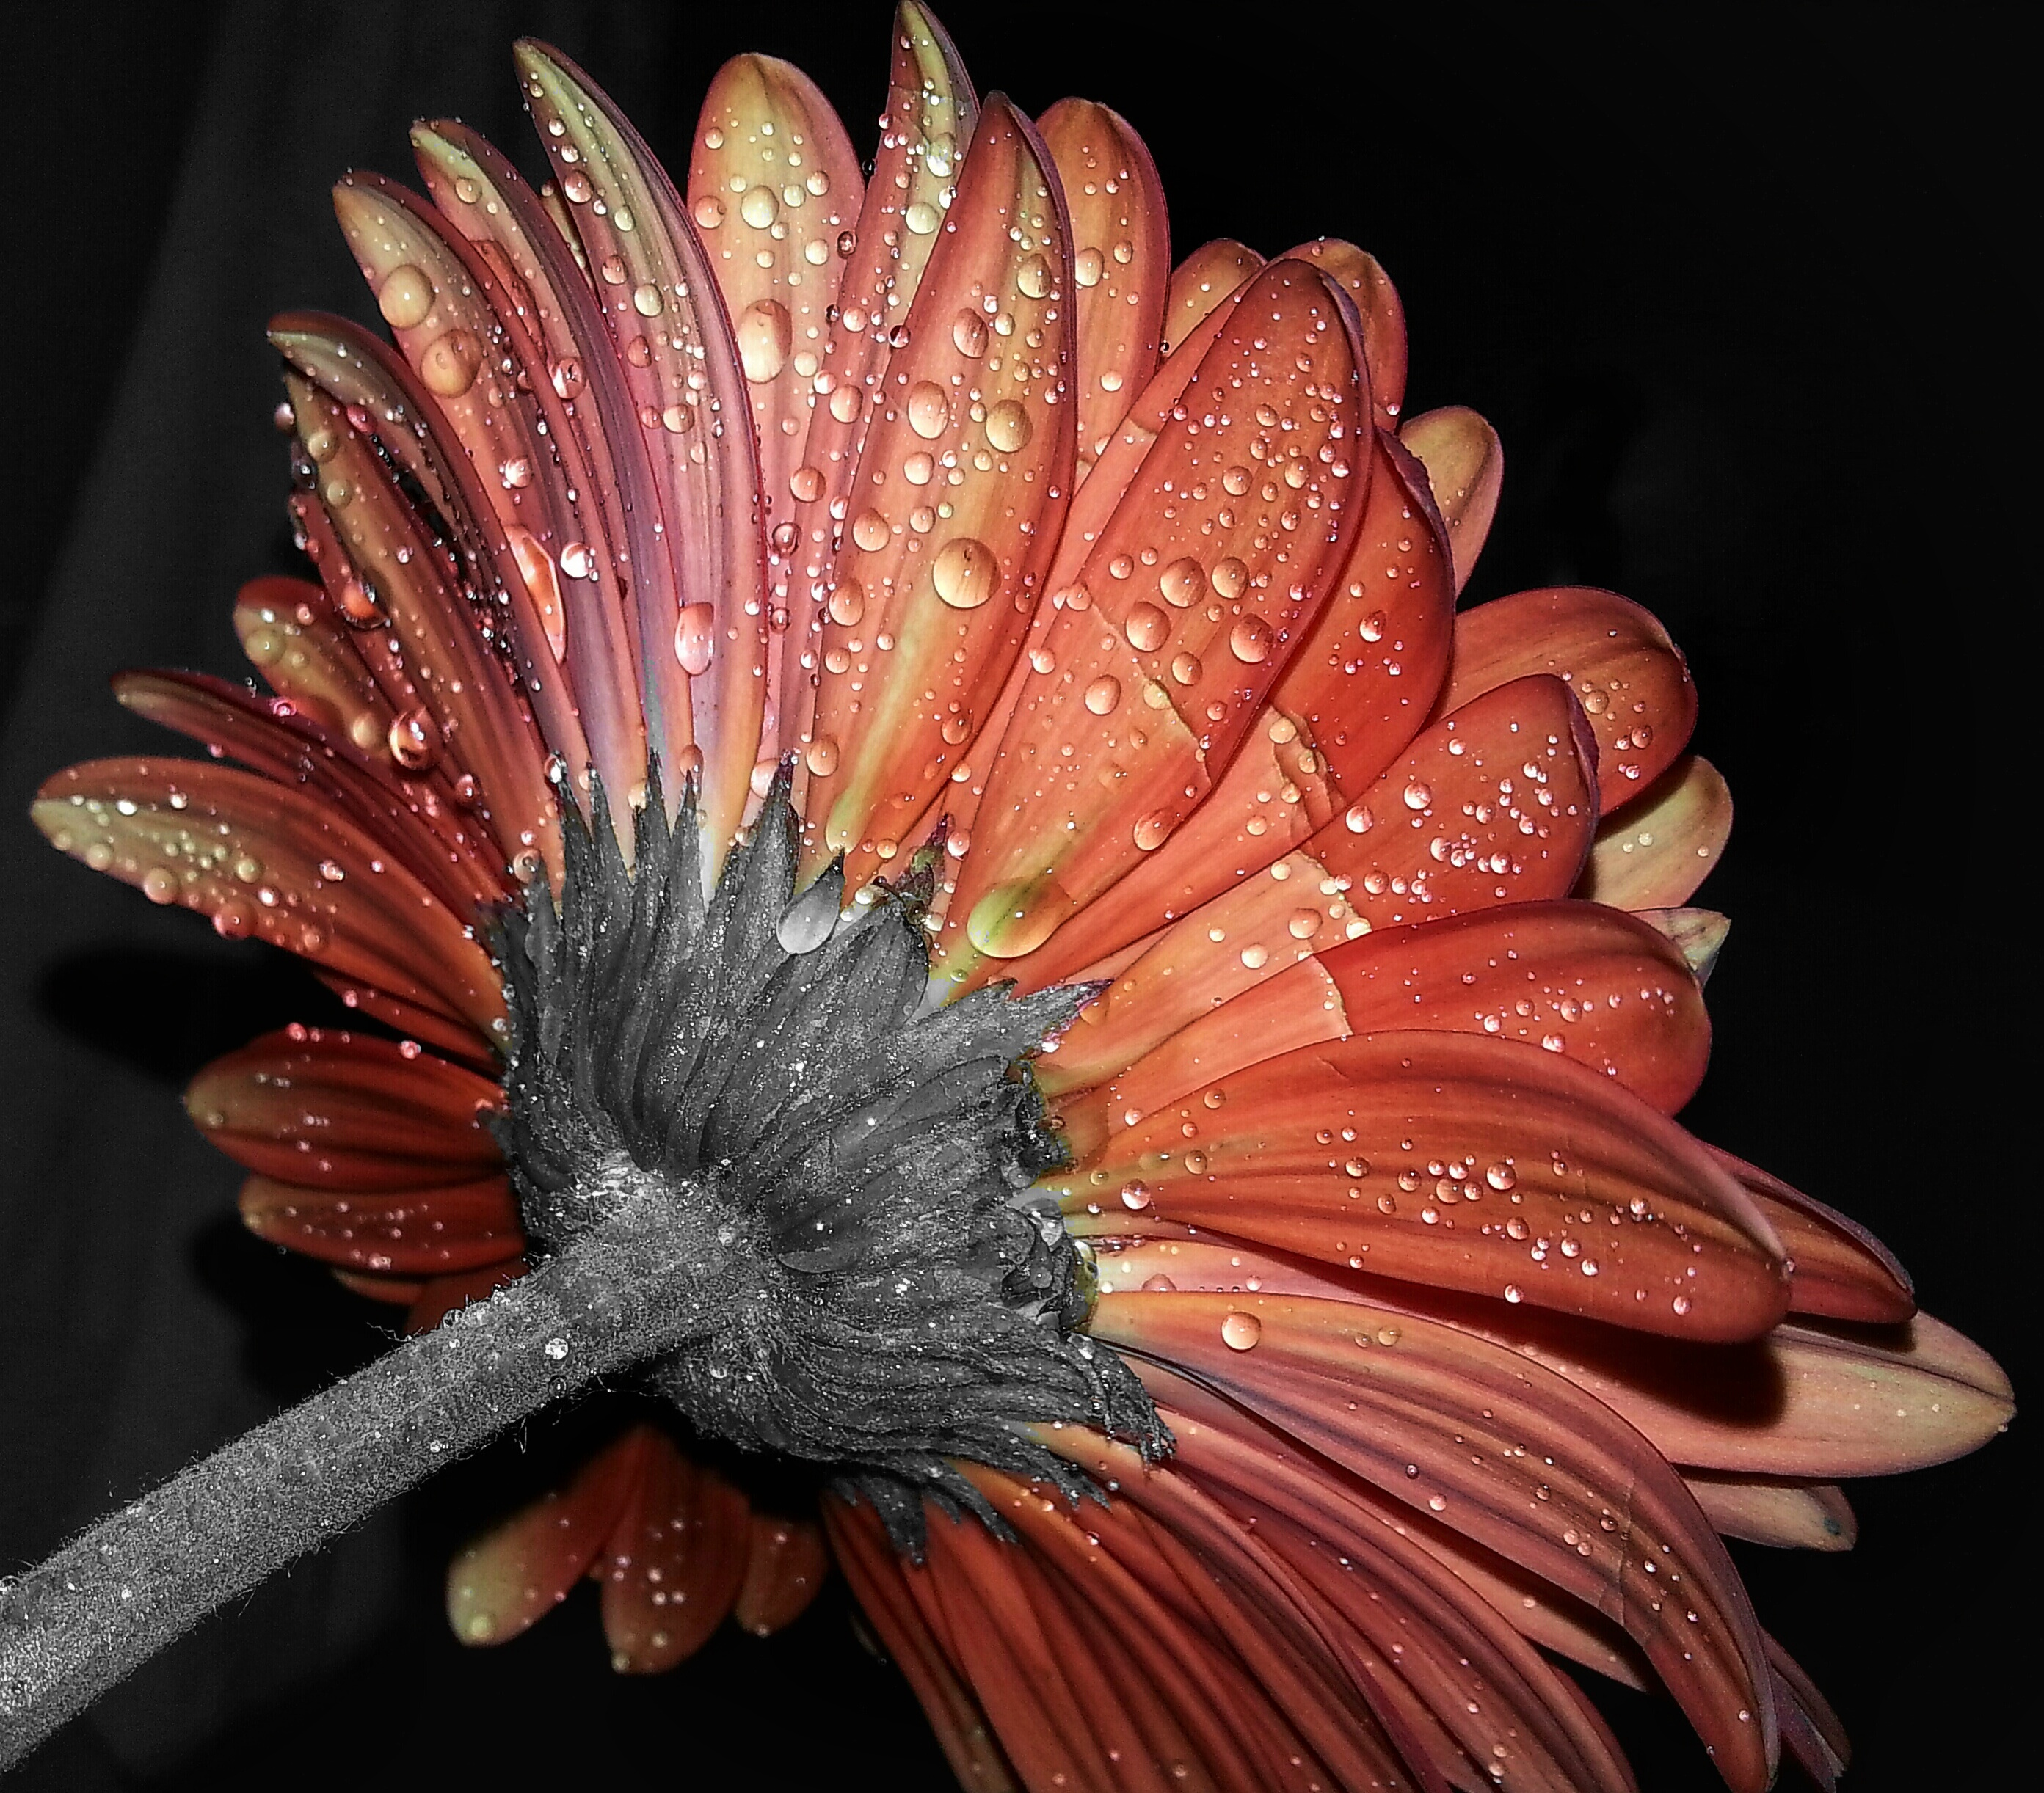
ORYM: Analysis
Indexing All Sources
Identifying Gaps
Resolving Biases
Dissolving Myths
Conclusion(s)
Start writing . . .

Slide 24

Digging Into The Details
Minutia make the moments real
Focused perspective adds meaning, substance
Actions and decisions reveal motivations
Rudimentary tasks strung together = life

Slide 25
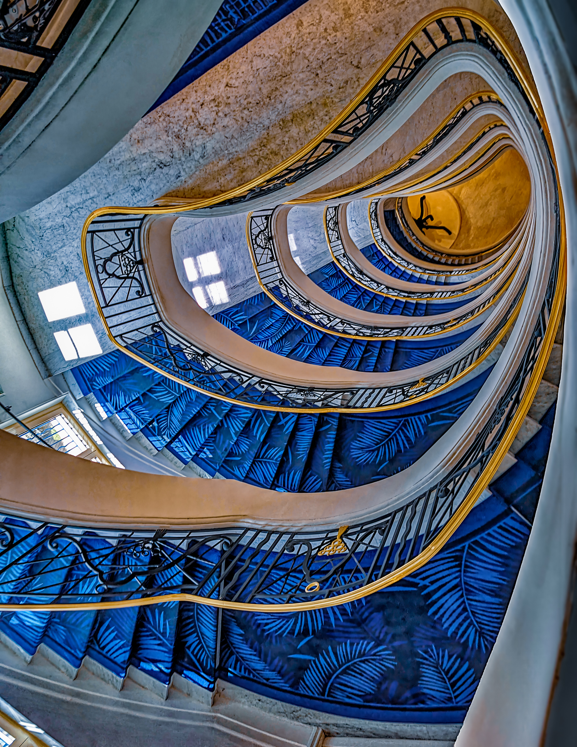
Building An Acrobat Index
BENEFITS
Leverage the Acrobat Search Feature
Works with Pro or Standard (free)
Built on one folder or many (subfolders)
Minutes to create, dynamic updates
Files produced from ANY pdf engine
DETRIMENTS
Only works on Adobe PDF files
Speed depends on machine
Only Files with OCR / Searchable Text

Slide 26
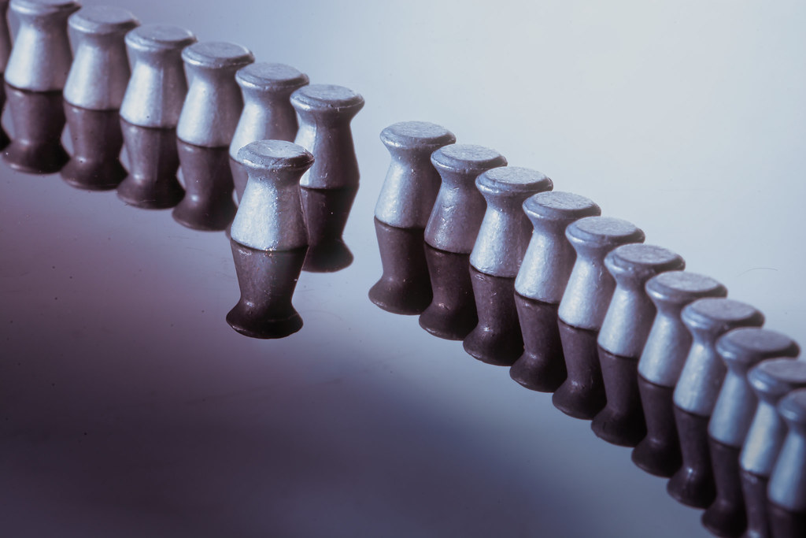
Metadata
Data about the data
Also called ‘Tags’
The origin of #Hashtags
Files, photos, folders, collections
Leverage existing, add your own

Slide 27
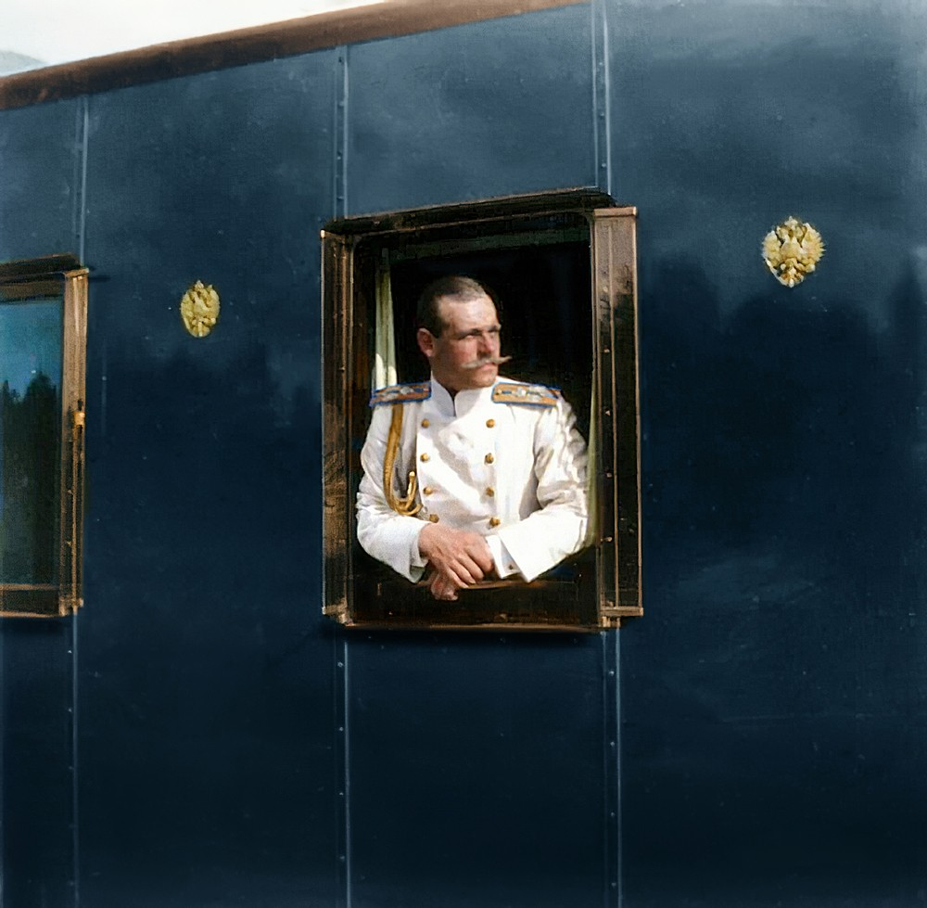
Dispelling the Myth(s)
Biographies Can Be Biased
Consider the motivation of the author
Supporting Characters Reveal More
Someone of the time disliked them – find that person or group
‘Knocking their halo askew’
Heart of Flesh Literary Journal

Slide 28
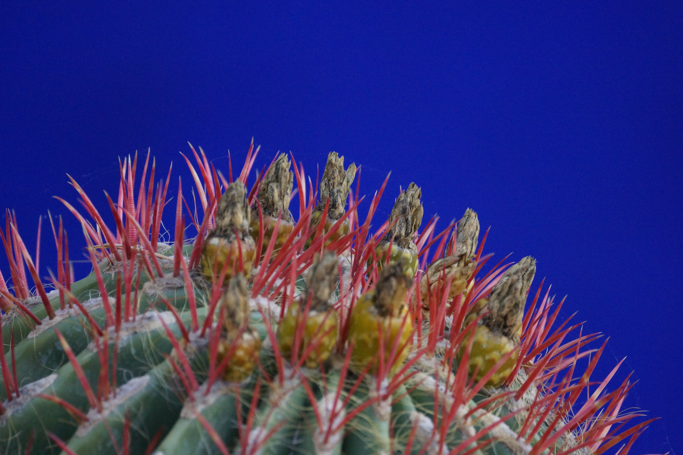
Resolving Biases
Evaluate what changed in your own view
Highlight text or works that contradict
Complete absence might be too shallow
Reference positive ‘images’ of enemies

Slide 29
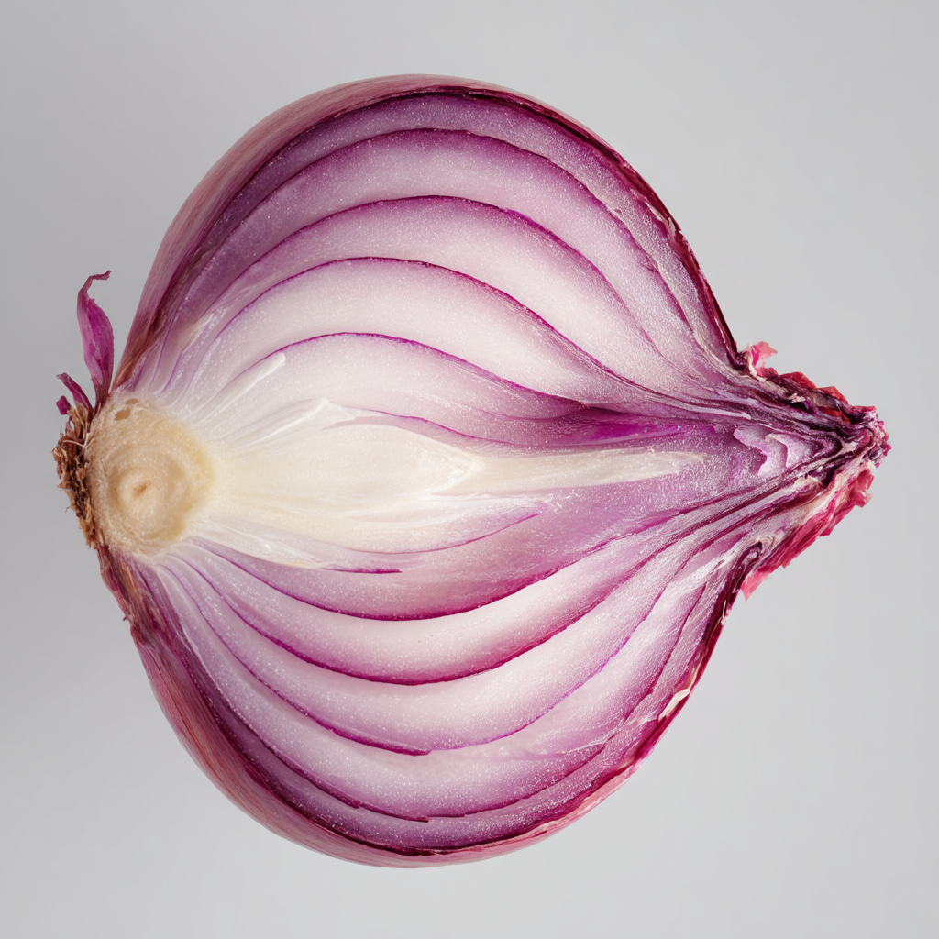
Peeling the Layers
Evaluating what is ‘enough’ for sources
Leveraging lists or indices for completeness
Watch for ‘tipping point’ with similarities
Self Tests for Completeness:
Can the full story be conveyed with sources?
Has the ‘collecting buzz’ worn off?

Slide 30
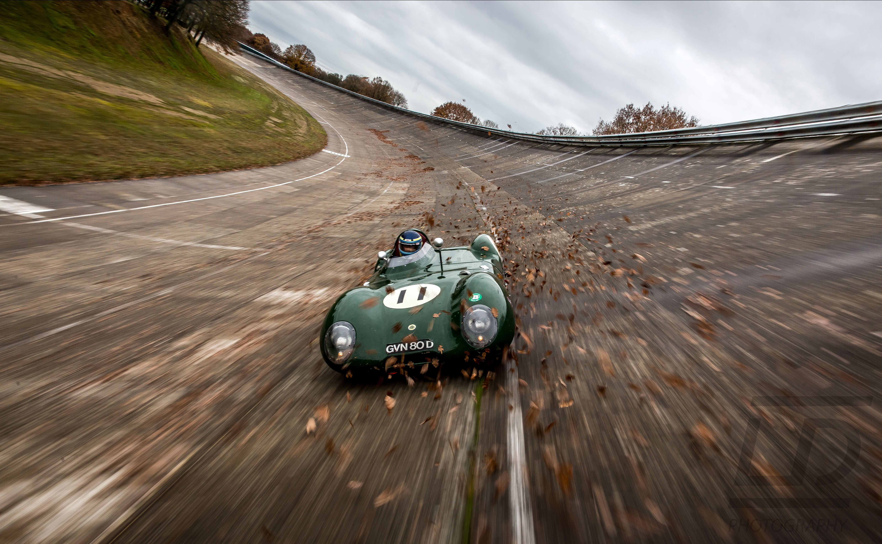
Questions, Discussion, Corrections?

Slide 31
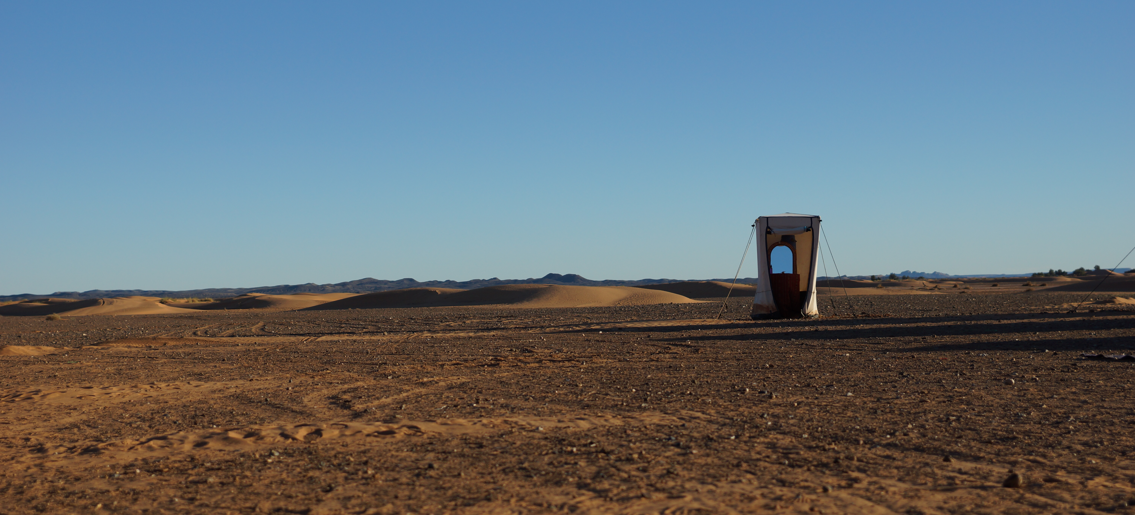
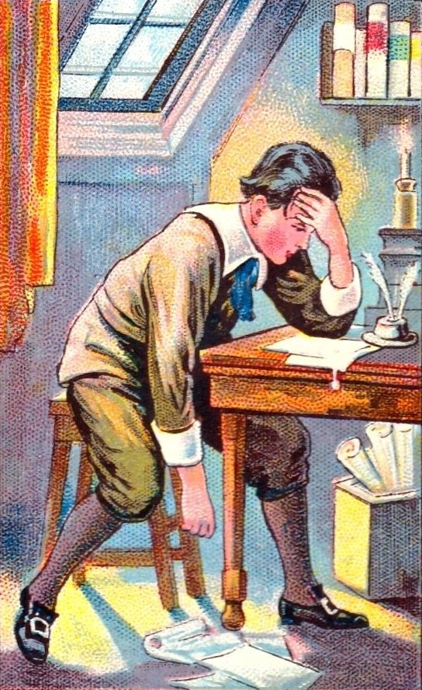
As you enter that wasteland of information, be prepared and cautious!
Thank you

